Slide 1

Metonymic Language Models
Literary Data after AI
Ben Glaser, Yale University
Ideogram.ai being very literal →
Notes:
Gratitudes: Mahdi / Poetics; the work of Stanford Lit Lab. Lots of Stanford!
Ryan Heuser (+ foundational work by Kiparsky and Hanson, and also Tarlinskaja)
+ historical prosody and poetics – separate topic
Caveats
Short notice; some repetition with discussion later today though that is more about genre
My limited background in DH – trained in poetry and poetics, invested in digital methods and have begun teaching in that area. Most of you will have way more experience than me in digital archival methods, database management, graphical design, programming, honestly probably most things. I’m hoping to collaborate on data curation and analysis for poetry as a way of bracing ourselves as humanists for this era of gen AI.

Slide 2
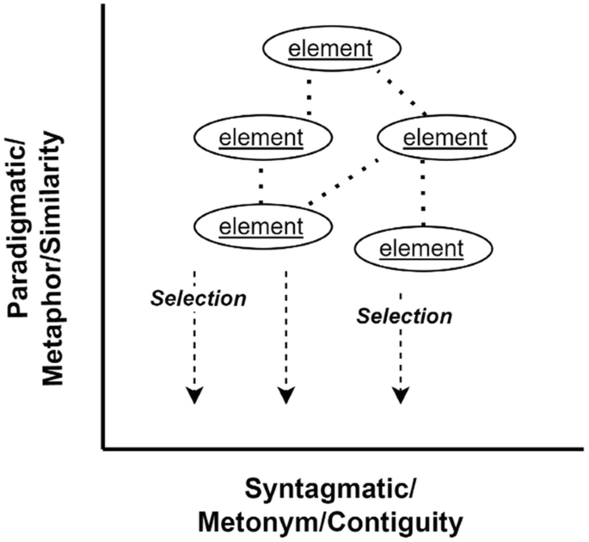
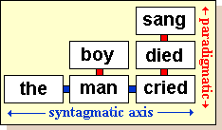
Why “metonymic”?
Roman Jakobson:
Poetic Function: “The poetic function projects the principle of equivalence from the axis of selection into the axis of combination. Equivalence is promoted to the constitutive device of the whole sequence”
Metaphor (similarity… somehow) vs Metonymy (association / syntagm).
“We am I here? Why am I now?
~ “Why am I me,” Shenandoah
Vs, “me is the object pronoun of I”
Or manchild vs “The man was still a boy”
Me: the poetic function involves the decision to repeat choices and thus bring attention to linguistic paradigms

Slide 3
AI vs Human metaphor
[adjectives bolded]
AI “metaphor”
Prompt: I need a brief metaphor for an ocean full of shipwrecks
ChatGPT’s Response (1/11/25):
“The ocean is a vast graveyard, its waves the restless mourners guarding the broken bones of forgotten ships.
Hart Crane claimed a “logic of metaphor which antedates our so-called pure logic”; " It is as though a poem gave the reader as he left it a single, new word, never before spoken and impossible to actually enunciate, but self-evident as an active principle in the reader’s consciousness henceforth”
And wrecks passed without sound of bells, The calyx of death’s bounty giving back A scattered chapter, livid hieroglyph, The portent wound in corridors of shells.
(“At Melville’s Tomb”)
ChatGPT’s analysis of Crane:
This metaphor is dense and evocative, filled with imagery that reflects themes of death, mystery, and the passage of time. Let’s break it down…
…
The "wound" could symbolize the damage of the wreck, but also a deeper existential scar, concealed within the ocean’s beauty. [oops!]
Notes:
Edelman / Reed on Crane: a thicket of poetic tropes so snarled, so dense that one can despair of ever comprehensively analyzing its purpose and function. Oops, “wound”’s primary disambiguation should be another wound…
Eileen Miles, quoted in I am code: surprise in poetry “is the contribution of the body to poetry” (xlvii).

Slide 4
Sample training data for “Co-poet”
Task | Prompt | Response
“Start / End” | Generate a poetic sentence about 'parodies' and ending in 'order' | Even in parodies ‚Äî there was order
“Haiku” | Write a haiku that includes the word 'Military volunteer' | Donkey engineer / Military volunteer / celebrates new year
“Rhyme” | Write a poetic sentence that ends in a word which rhymes with 'raise' | The eyes that fix you in a formulated phrase
Simile / Metaphor | "Generate a metaphor about 'canvas'" | The canvas is a patchwork
Chakrabarty, Tuhin, Vishakh Padmakumar, and He He. “Help Me Write a Poem: Instruction Tuning as a Vehicle for Collaborative Poetry Writing”

Slide 5
Contrast: Yeatsian “Symbol”
Yeats, “The Tower” (1928) [bolds mine]
“I pace…
…and call
Images and memories
From ruin or from ancient trees,
For I would ask a question of them all.
…
I myself created Hanrahan…
…
I thought it all out twenty years ago.
[limited use of adjectives]
…
I mock Plotinus’ thought
And cry in Plato’s teeth,
Death and life were not
Till man made up the whole,
Made lock, stock and barrel
Out of his bitter soul,
Aye, sun and moon and star, all….”
Notes:
Mild irony here, the merism / metonymy “lock stock and barrel” is used by Walter Scott in 1817, not terribly common until the 1970s

Slide 6
Word vectors/embeddings as a common ground of disambiguation or semiosis?
Common acts of “disambiguation”?
Michael Gavin: “[William Empson] established disambiguation as a primary critical activity… rather than disambiguate words …meanings could be held in productive interpretive juxtaposition”
“Vector-space models can be used in much the same way that Empson used the dictionary, not to reduce words to a meaning in context, but to expose their many possible connotations.”
Common “semiotic acts”?
Paul Kockelman, Last Words: “the intentionality …of the trained model is derivative not just of the intentionality of the humans that trained it…but also the intentionality of the humans who produced the texts and instructions it was trained on” (28)
Q: Do we agree? How are those two “ambiguities” or “intentions” aligned or misaligned?
Notes:
Convergence? Pause for question --

Slide 7
Poetics and Prosody: What do LLMs know? How can we study both behavior and latent space?
McCoy et al, “Embers of Autoregression Show How Large Language Models Are Shaped by the Problem They Are Trained to Solve.” Proceedings of the National Academy of Sciences 121, no. 41 (October 8, 2024)
Beguš, Gašper, et al., “Large Linguistic Models: Analyzing Theoretical Linguistic Abilities of LLMs” (Manuscript, Aug 2023)
“Co-poet”: Chakrabarty, Tuhin, Vishakh Padmakumar, and He He. “Help Me Write a Poem: Instruction Tuning as a Vehicle for Collaborative Poetry Writing.”
Walsh, Melanie, Anna Preus, and Maria Antoniak. “Sonnet or Not, Bot? Poetry Evaluation for Large Models and Datasets.” arXiv, October 10, 2024.
Walsh, Melanie, Anna Preus, and Elizabeth Gronski. “Does ChatGPT Have a Poetic Style?” arXiv, October 20, 2024.
Heuser, Ryan. “Generative Humanities,” n.d. (2024 manuscript)
Notes:
Discuss the genre level studies – walsh impressive data and statistical method but not theory of poetry / form

Slide 8
Computational Work in Metrics
[A Selection]
Marina Tarlinskaja (statistical, not computer-aided)
Stanford Lit Lab:
Prosodic.py
“Transhistorical Poetry Project”
J.D. Porter, “Hood Distance” [or rather “Hood Vector]
Ryan Heuser, “Generative Humanities” (2024, manuscript)
Notes:
Pivot here briefly

Slide 9
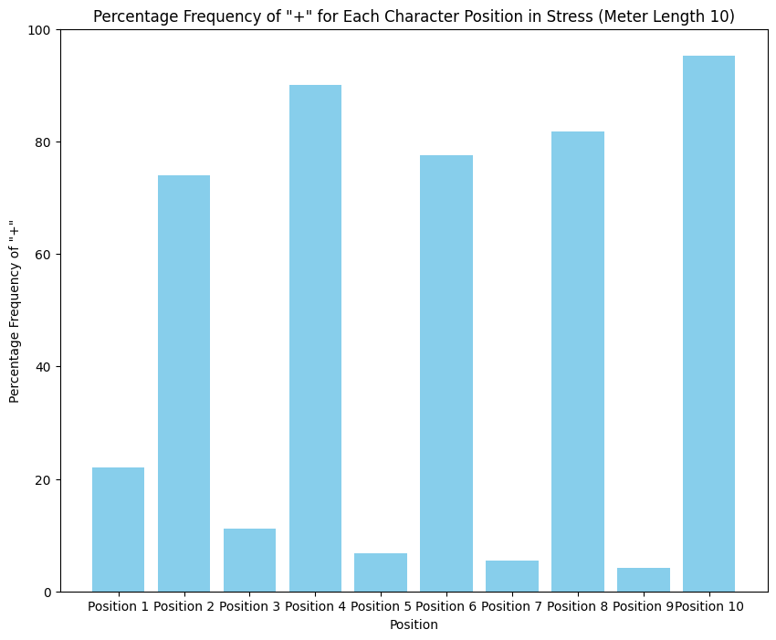
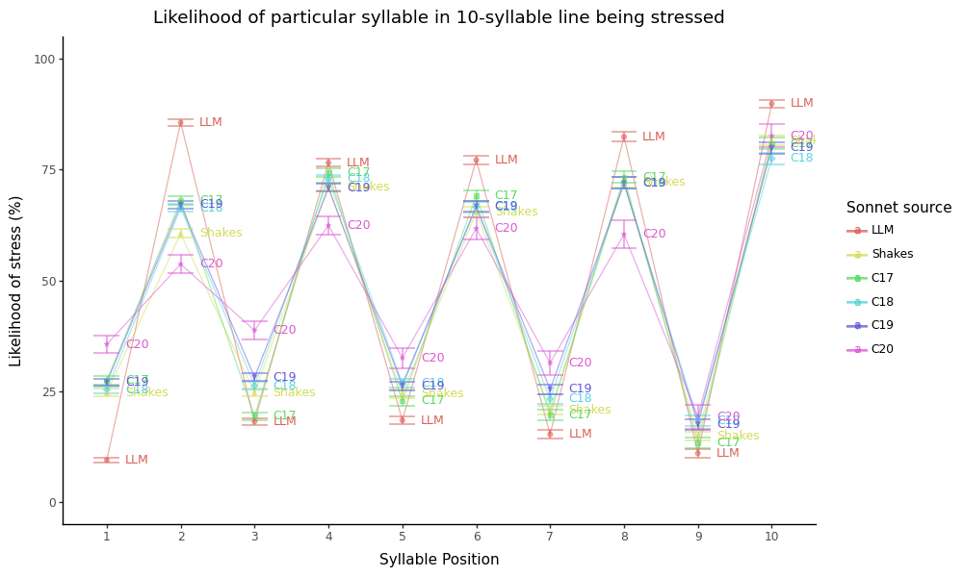
Stress counts
Positions | 2 | 4 | 6 | 8 | 10 | Mean 2-8
Pope | 78 | 98 | 74 | 86 | 99 | 84
Byron | 71 | 80 | 76 | 70 | 94 | 74
Shakespeare | 61 | 82 | 73 | 69 | 93 | 71
Frost | 61 | 79 | 75 | 74 | 94 | 72
Donne | 61 | 80 | 67 | 71 | 78 | 70
10-syllable prose | 38 | 40 | 48 | 38 | 80 | 48
Tarlinskaja
Heuser
Glaser (18C iambic pentameter)
Notes:
Comment on position 4 in frost and donne. I would add wyatt vs Sidney, stevens…

Slide 10
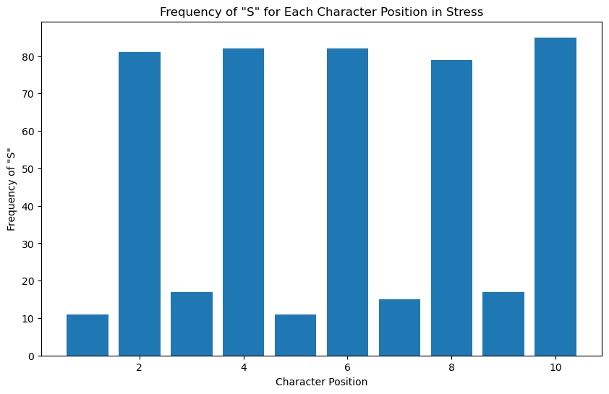
S frequency (cont.)
AI verse (4o, prompted for variations)
18C, again--

Slide 11
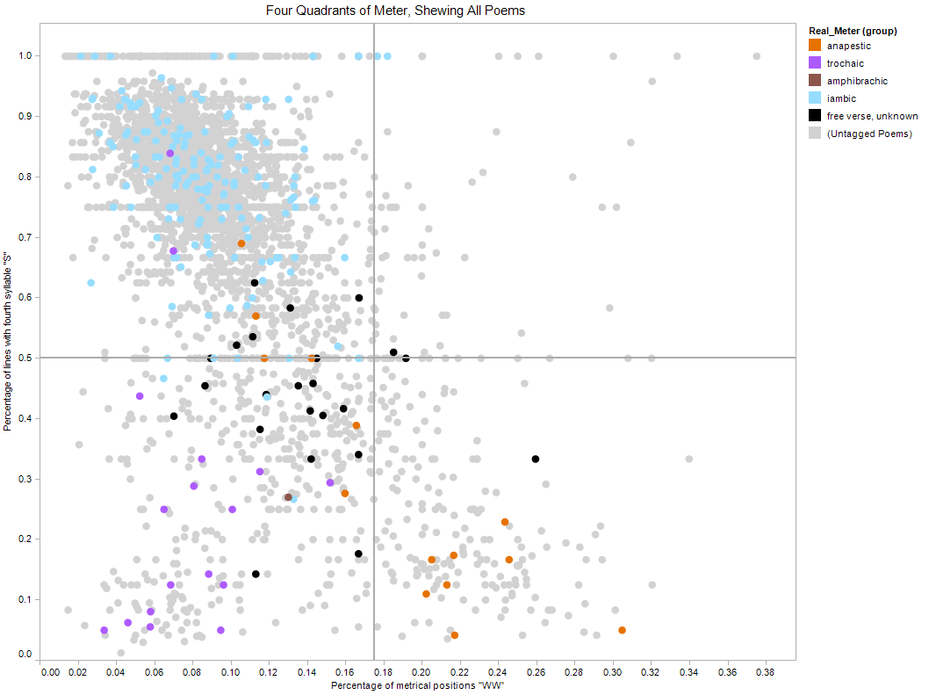
Porter’s “Hood Distance/Vector”
https://litlab.stanford.edu/hooddistance/

Slide 12
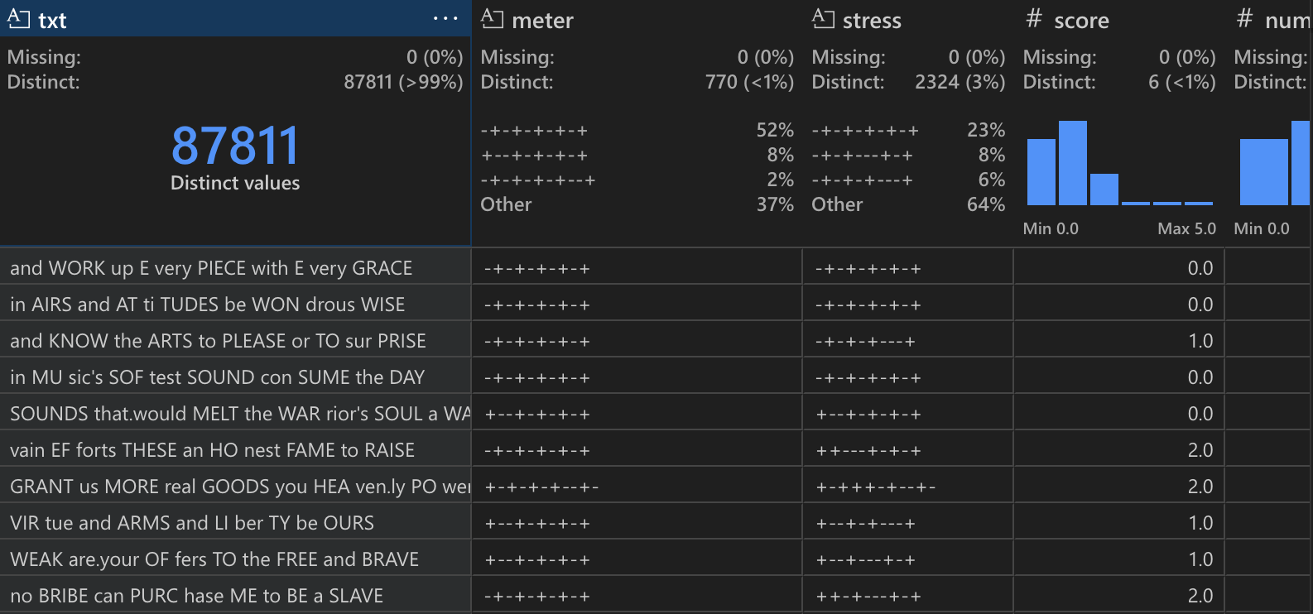
Big Scansion Dataframes (not pictured: xml and xquery)
Notes:
Open github
Or
vscode – my god the number of things I would critique about my own data at this stage!

Slide 13
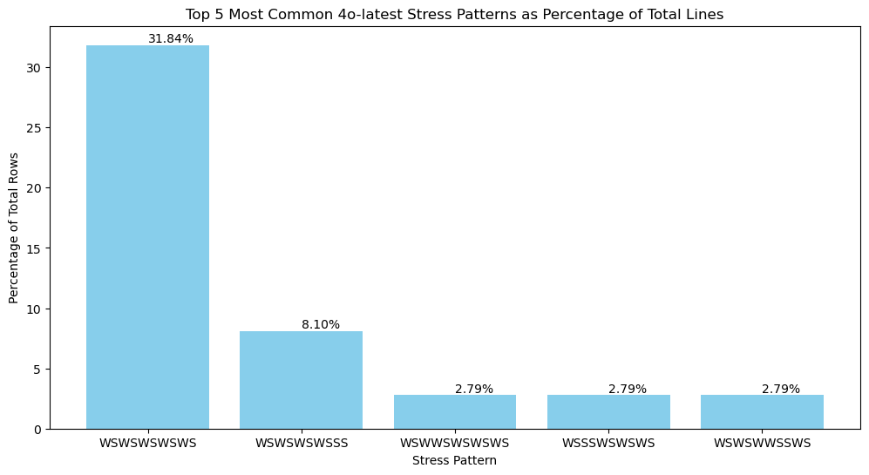
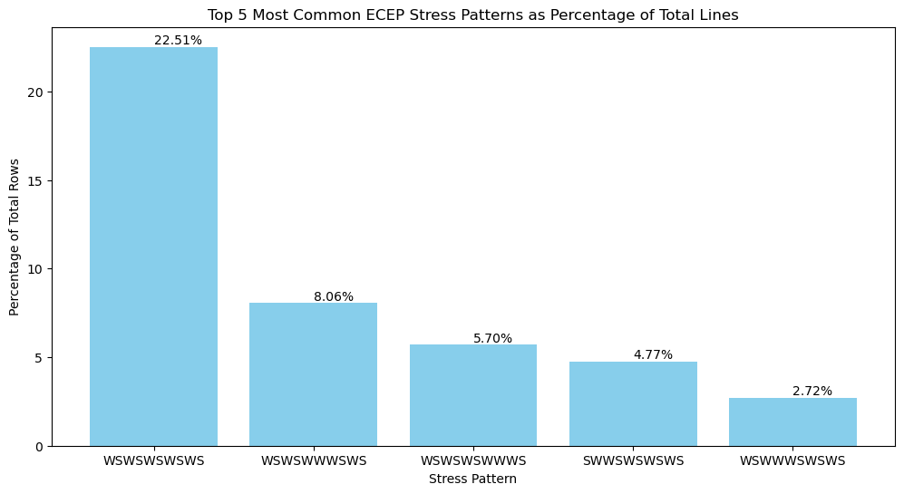
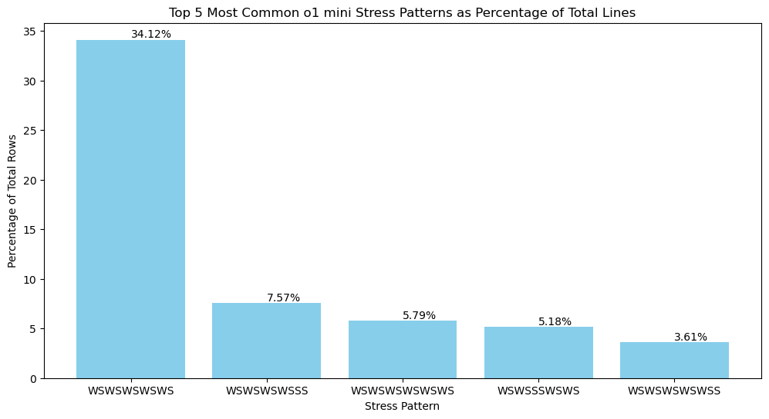
Some comparison of 18C and AI verse

Slide 14
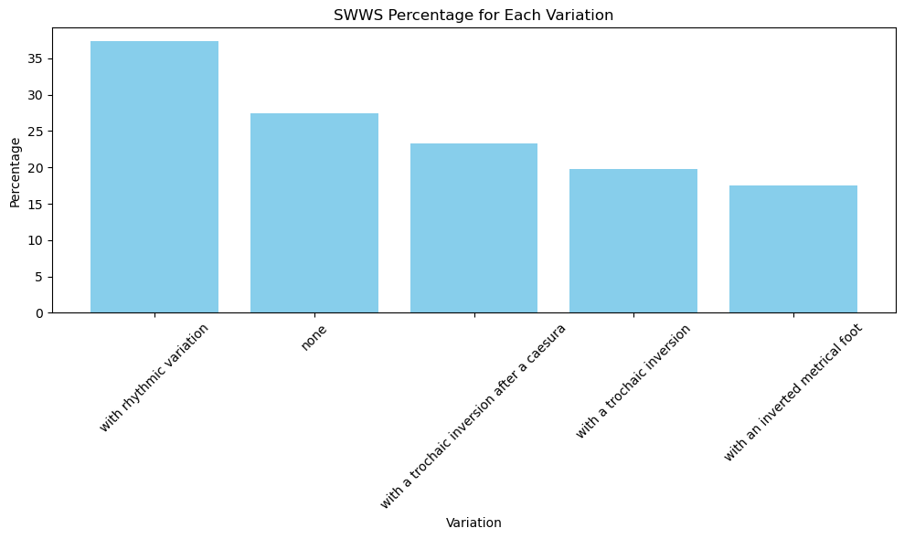
Does the rhythmic figure “SWWS” appear in a corpus / given prompt?
Paradoxical results…
4o-latest:
O1-mini without variation prompts:
13.33% SWWS
ECEP:
28% SWWS
Somehow not a single o1-mini line begins SWWS

Slide 15
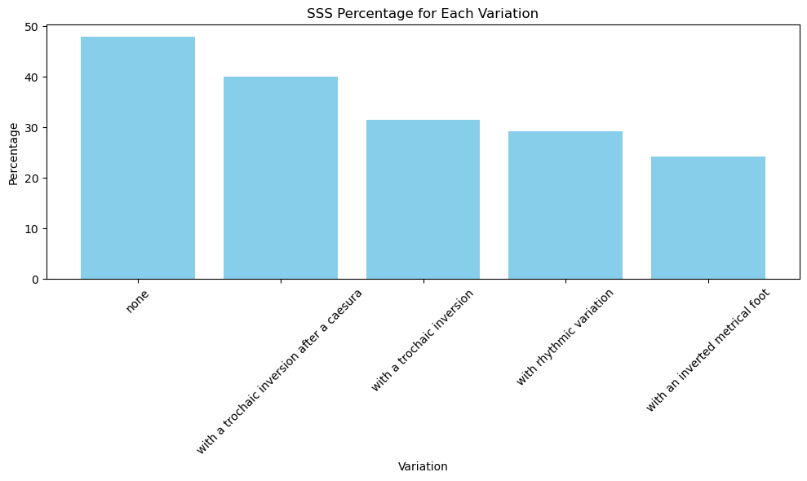
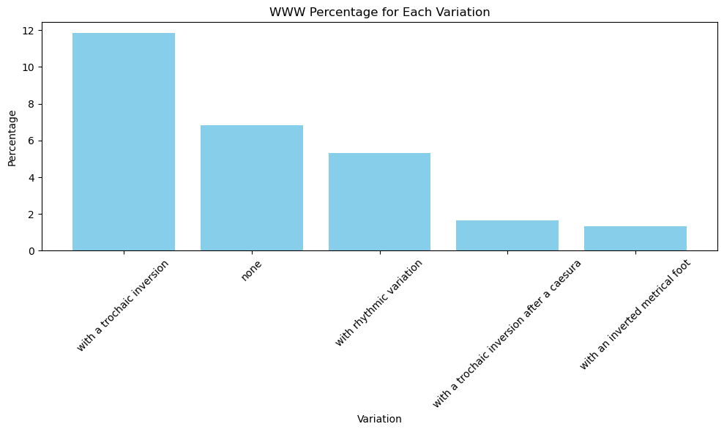
How often do WWW and SSS appear in “stress”?
SSS:
ECEP: 10%
o1-mini: 33%
4o-latest:
WWW:
ECEP: 41%
O1-mini: 4.7%
4o-latest:
(human verse is much lighter)

Slide 16
Rare Lines or rhythmic “figures”
Deep in the Eighteenth Century Poetry Archive lurk the rarest of line shapes, outside the taxonomies of prosody: WSSWWSSWWS
“With Rome's august remains, heroes and gods,” (John Dyer, a Welsh poet, The Ruins of Rome, 1740)
[But likely auGUST from the poet’s other usage]
“She beat her bosom, and she tore her hair!
She look'd now on the ground, now on the skies”…
~Jerome Stone, from “ALBIN and the DAUGHTER of MEY. An old tale, translated from the Irish.” 1757)
Others?
HEAR the WILD.ROAR of.the TEM.PES tuo.us BLAST
a VOICE.HEARD by.the DEAF SPOKE by.the DUMB
LIES a VAST.MO nu MENT once GLO rio.us ROME
Notes:
Note: any of these might be scanned differently. But they show a high distance, or unique vector, from the entraining WSWSWSWSWS. Their content knows it – mimetic of either foreign prosody / style, or extreme volume or dissonance. Rome, Ireland, Welsh poets, etc.
Obv could be ”august”

Slide 17
Rough fine-tuning produces metrical variety
Gemini flash 1.5, Fine-tuned vs Prompted. Red marks odd-positioned caesurae or strong phrase boundaries; green marks even ones. August 2024
Notes:
Any ren folks / miltonists here? Which column do you choose?

Slide 18
Student work from “Poetry and AI”
ShakesBERT
RhymeVis
Poeticity / Type Token Ratios / Sonnet analysis

Slide 19
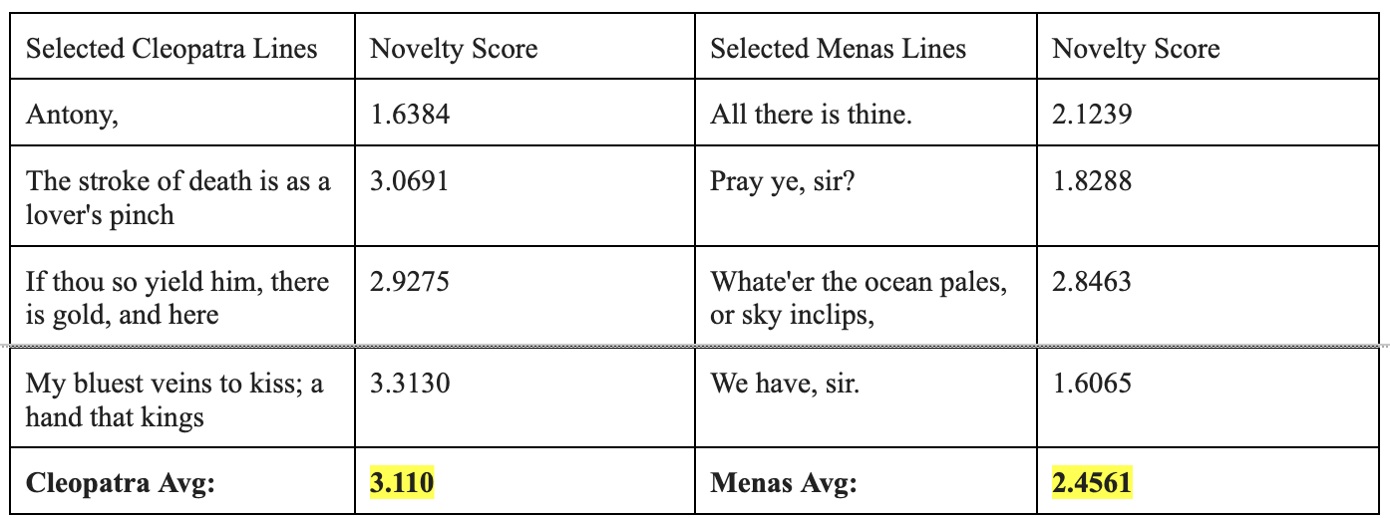
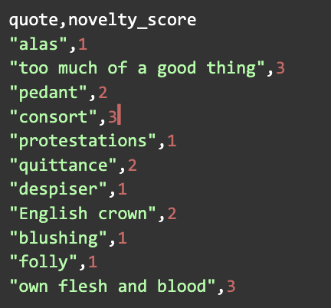
ShakesBERT
Method: Student collected about 300 words and phrases (aiming for 1-2k but it was hard!) from Shakespeare. Then checked their frequency in the 16th century corpus from EEBO and assigned novelty score.
Then fine-tuned / trained BERT on this classifier task and set it loose on other Shakespeare texts and passages.

Slide 20
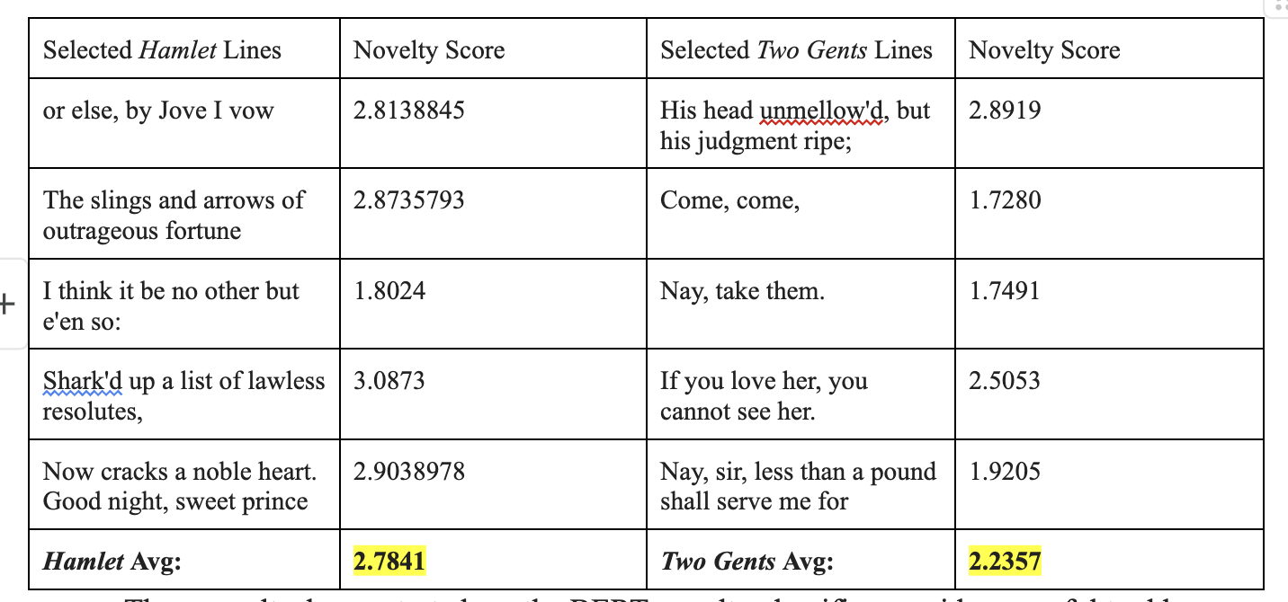
Notes:
Novelty score may correlate to metrical diversity / “score”. “broken backed lines”, high stress clash, etc

Slide 21
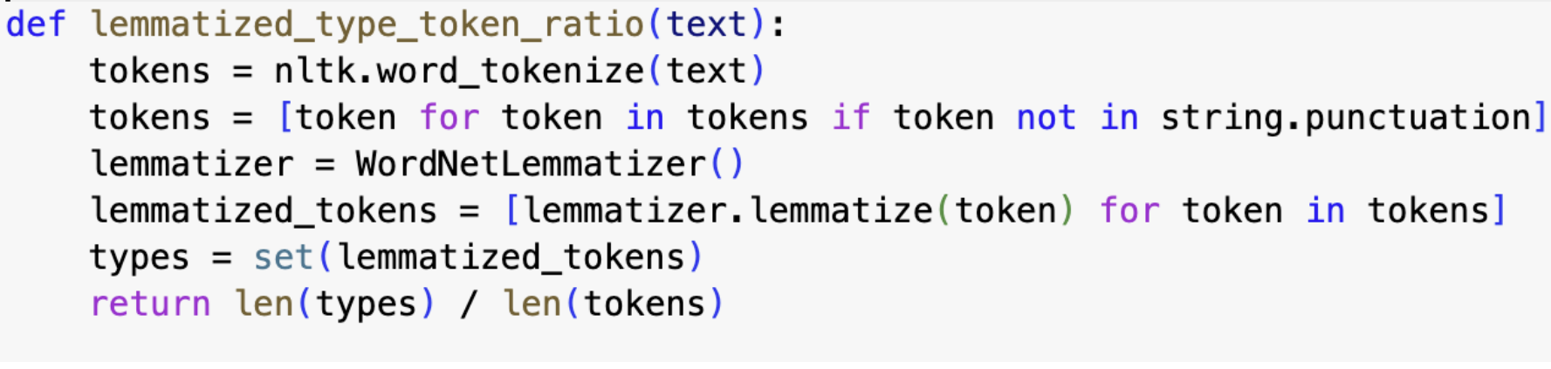
TypeTokenRatio: Poetic Function in Shakespeare’s sonnets.
“No linguistic property of the verse design should be disregarded” (Jakobson)
Lemmatization calculator:
(think Sonnet 129, “Had, having, and in quest to have, extreme”…)

Slide 22
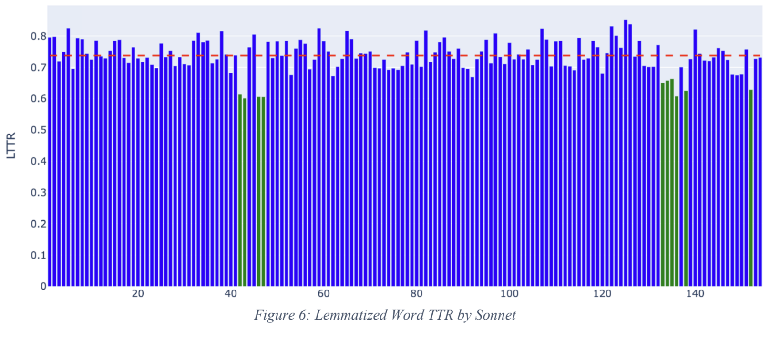
TTR: Lemmatization density across Shakespeare’s sonnets
Notes:
Sonnets 134-138 have a lot of “will” “wilt” , slave to slavery, me my I,

Slide 23
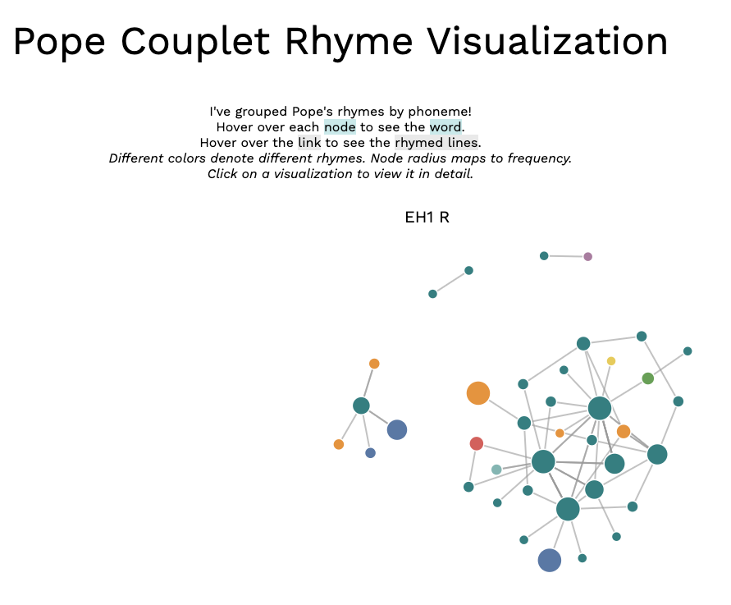
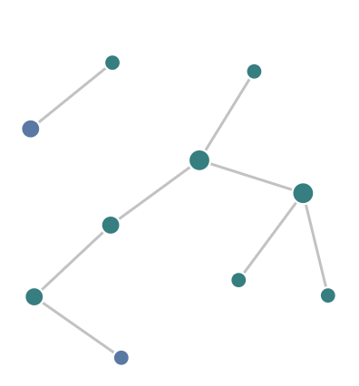
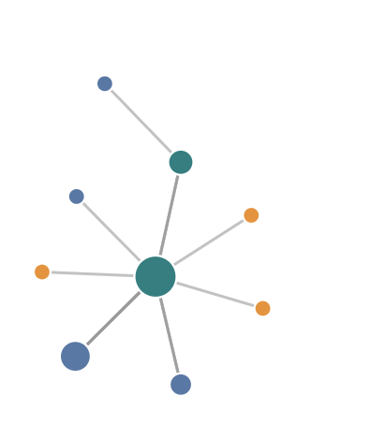
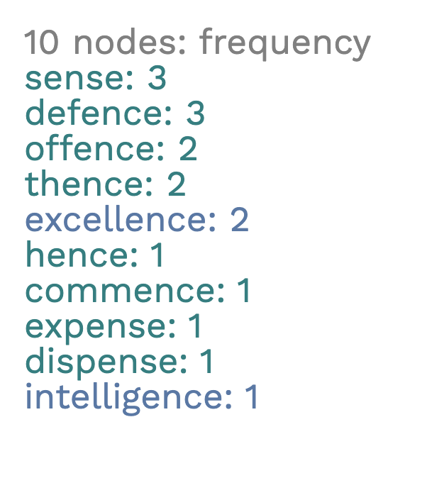
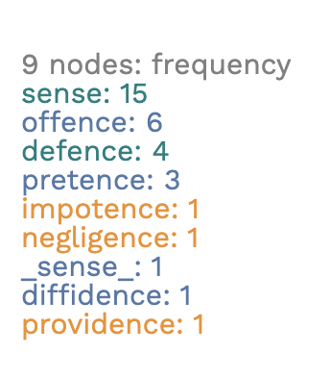
Rhyme Visualization with D3
Shakespeare Sonnets:
Pope Couplets
Notes:
https://rhymevis.glitch.me/pope.html

Slide 24
DH/ Teaching Questions
The facility of coding with genAI allows more ad-hoc tools like this for generating insights into text.
What data could scholars and students generate as a way of better understanding linguistic and literary structure?
What data and data formats do you need to get such projects going? (scraping, cleaning, formatting)

Slide 25
Impractical Criticism: Is this poem more like a Haiku or a Sonnet?
The apparition of these faces in a crowd:
Petals on a wet, black, bough.
Notes:
interlude

Slide 26
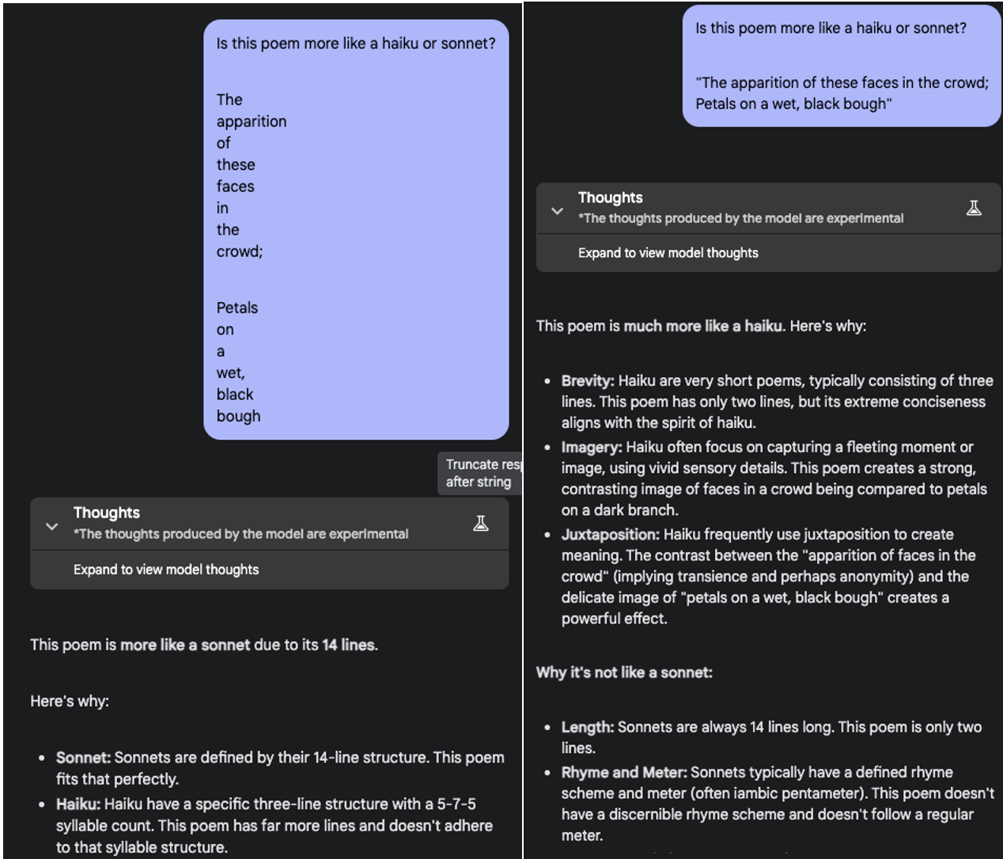
Notes:
Discuss cinquains… claude is completely blown out by the “didactic cinquain” which is apparently a thing in elementary education.
Line One: One noun Line Two: Two adjectives Line Three: Three verbs Line Four: Four-word phrase Line Five: One different noun

Slide 27
Workshop Topics
Accessing LLM’s “meta” / disciplinary knowledge
New datasets + new training or fine-tuning objectives
In general, what measures are available for contrasting LLM text and Human language?
Text-to speech performance, autoencoder precision, ability to parse sound + syntax (non-lexical), ability to work over specific linguistic domains (as opposed to everything digitized)

Slide 28
Assessing LLM’s disciplinary performance
I suggest the following three or four categories as ways into the LLM “black box” of pre-training data, embeddings, instruction tuning, prompt framing. I leave out PCA (Principal Component analysis) and more advanced techniques for probing the latent space of LLMs. That is because I don’t know how to do them yet!
Training Datasets:
what is in them, if knowable? Provenance?
what tokenization is used and does that matter?
what is not included (because of tokenization, textual medium)?
Metaknowledge:
When prompted, what do LLMs “know” about the objects, genres, and even concepts at the core of our disciplines?
How can we structure prompts to analyze that understanding? (see Begûs on metalinguistics)
How do they approximate discipline-specific analysis?
Generative behavior:
What kind of (literary) objects do LLMs produce? With which prompts, prompt-chains, system instructions, temperature settings, etc?
Stretch goals: how would we construct datasets for divergent training or fine-tuning?

Slide 29
What fine-tuning, with what data? (or what Small Language Models)
Mistral-Haiku (Direct Preference Optimization)
My painfully inadequate Gemini-Milton
Novelty classifier / “ShakesBERT”
Notes:
Show huggingface

Slide 30
Workshop Summary (pick one per group)
Data
Can you imagine a dataset and/or training protocol that might realign an LLM (or Small LM) with the priorities and dynamism of your objects of study?
What means do you have for determining training data? What do you want to know about it?
Precision in Inference; Metaknowledge of Disciplines
How well do LLMs approximate your discipline-specific analysis?
What kind of (literary?) objects do LLMs produce? And with which prompts, prompt-chains, system instructions, temperature settings, etc?

